Slide 1

Online shopping system

Slide 2

agenda
TEAM MEMBERS CONTRIBUTION
FILE TREE
UML DIAGRAM
ENCAPSULATION
INHERITANCE AND CUSTOM INTERFACE
POLYMORPHISM
SORTING METHOD
EXCEPTION HANDLING
GUI

Slide 3
TEAM MEMBERS CONTRIBUTION
MEMBERS | ID | CONTRIUBTION
OMAR MAMON HAMED | 2100767 | PAYMENT INTERFACE PAYMENT METHODS CATEGORIES CLASS PRODUCT CLASS GUI
MARIAM HANY MAHMOUD | 2100437 | LOGIN CLASS START CLASS USER CLASS
SHAHED MOHAMED ABDELSALAM | 2100898 | ADMIN CLASS CUSTOMER CLASS START CLASS
NOURAN SALAH IBRAHIM | 2100532 | ORDER CLASS START CLASS SUBCATEGORIES CLASS
HABIBA EL-SAYED MOWAFY | 2100792 | PAYMENT INTERFACE PAYMENT METHODS REGISTER CLASS SHOPPING CART CLASS GUI

Slide 4
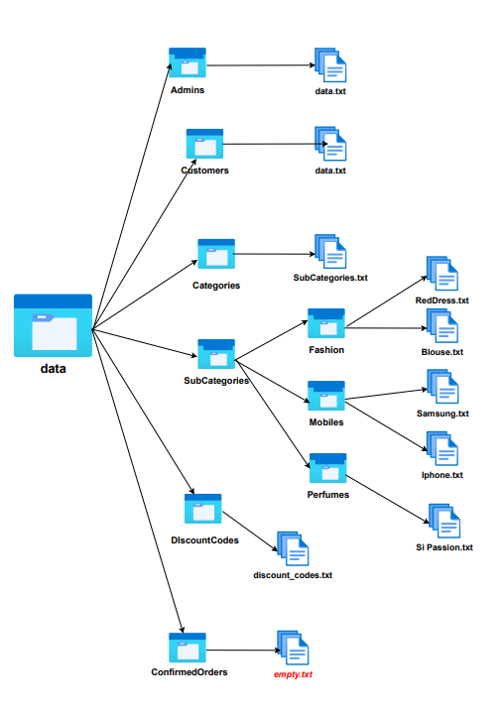
File Tree

Slide 5
UML DIAGRAM

Slide 6
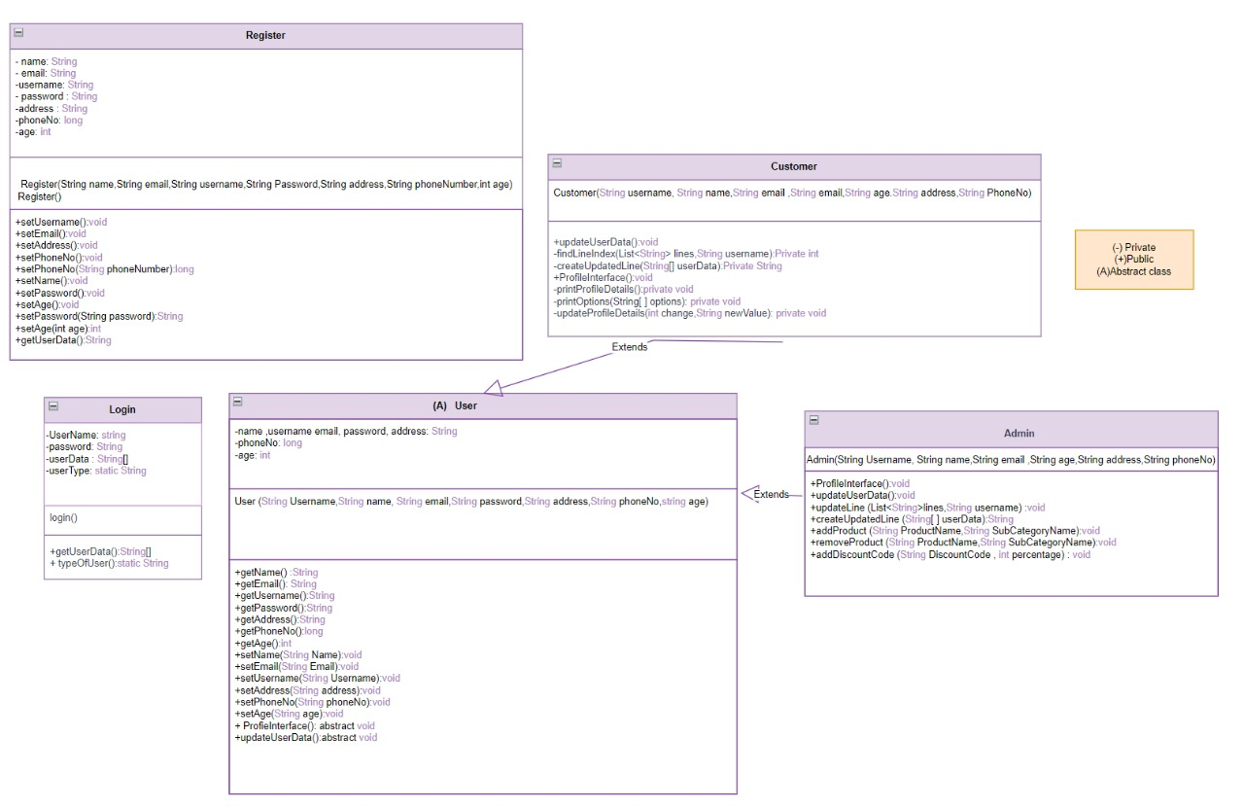

Slide 7
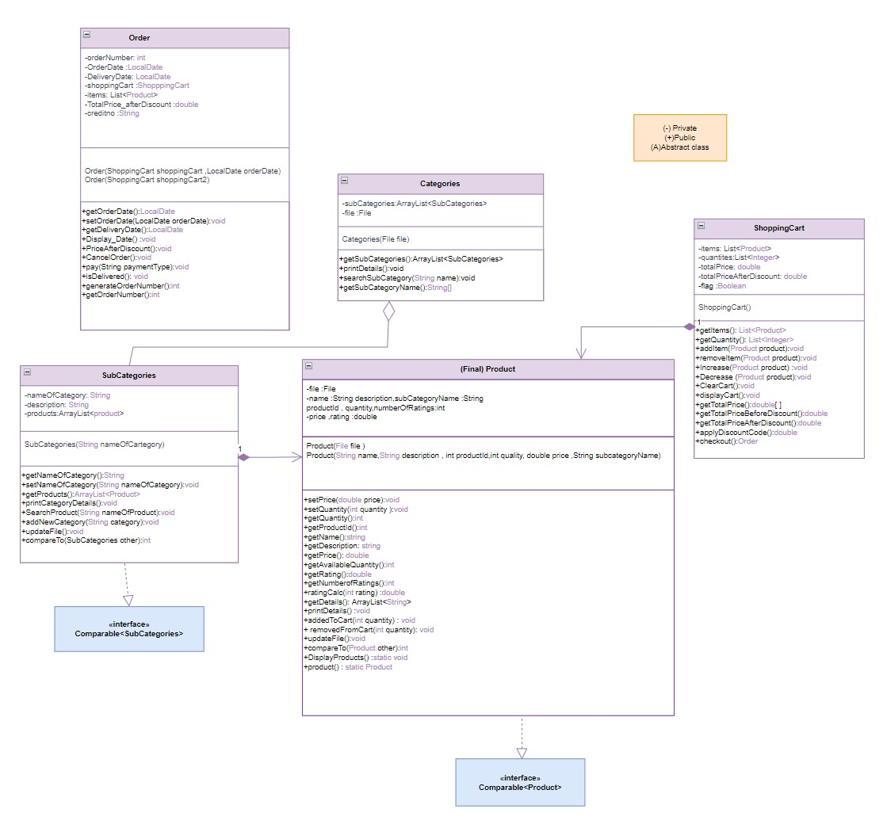

Slide 8
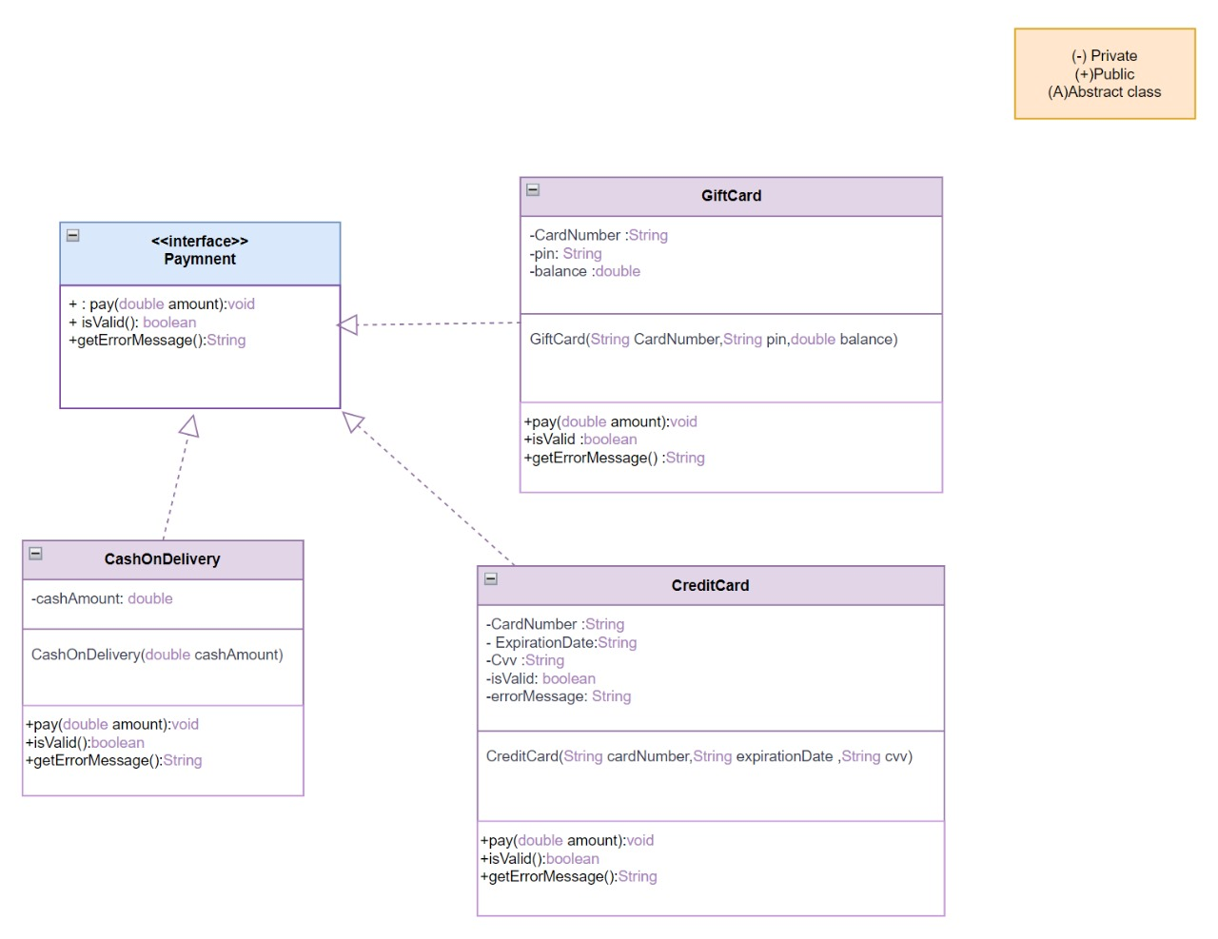

Slide 9
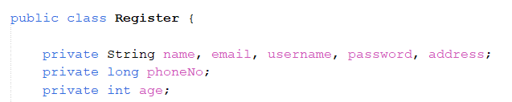
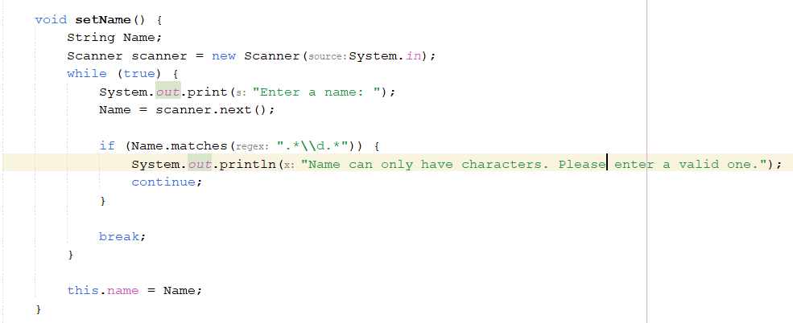
ENCAPSULATION

Slide 10
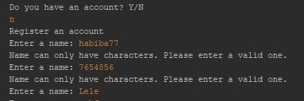
In console:

Slide 11
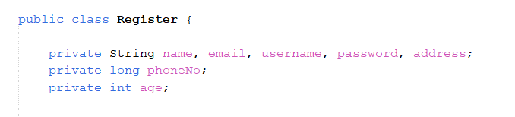
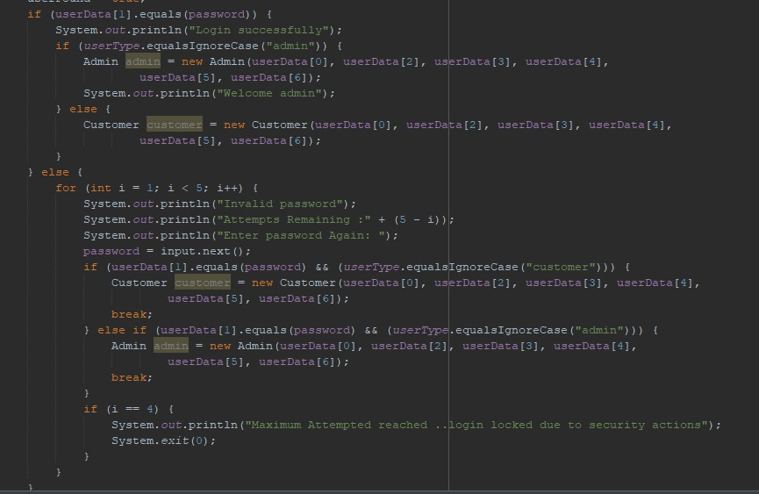
ENCAPSULATION

Slide 12
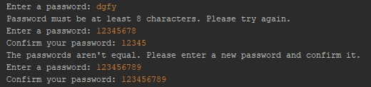
In console:

Slide 13
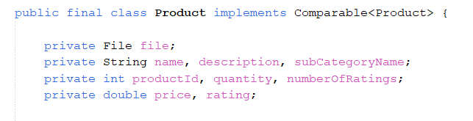
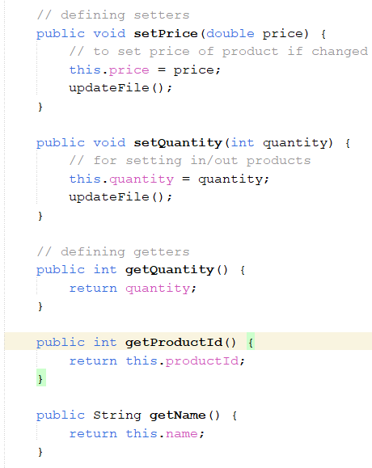
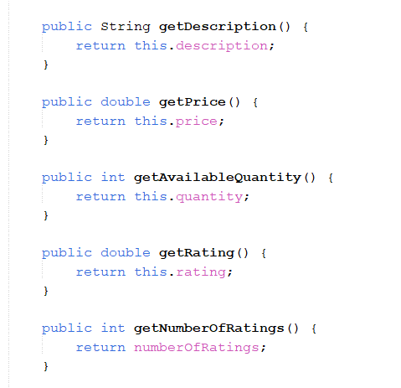
ENCAPSULATION
There is encapsulation in classes:
Shopping cart, order, subcategories, register

Slide 14
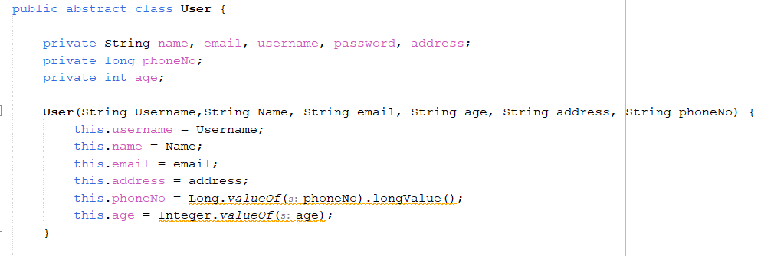
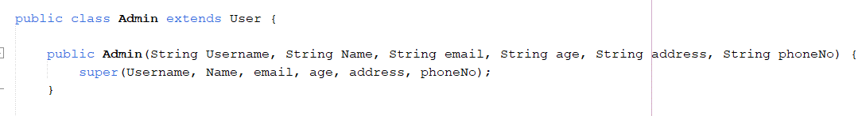
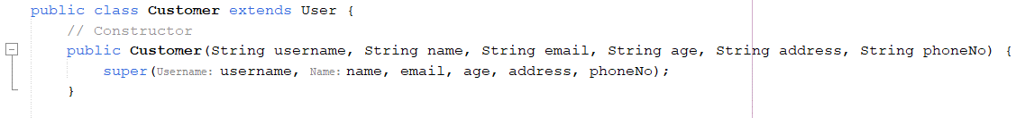
inheritance

Slide 15
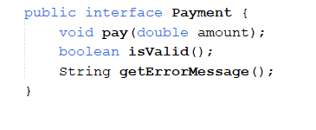
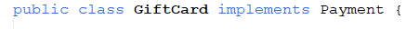

Custom interface

Slide 16
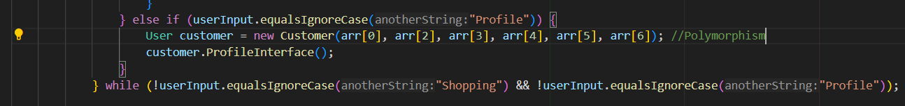
Polymorphism

Slide 17
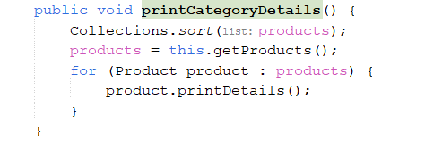
Sorting method
Sorting is done descending according to Product rating

Slide 18
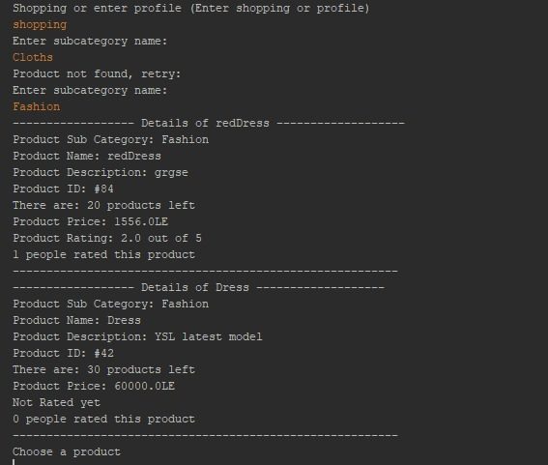
In console:

Slide 19
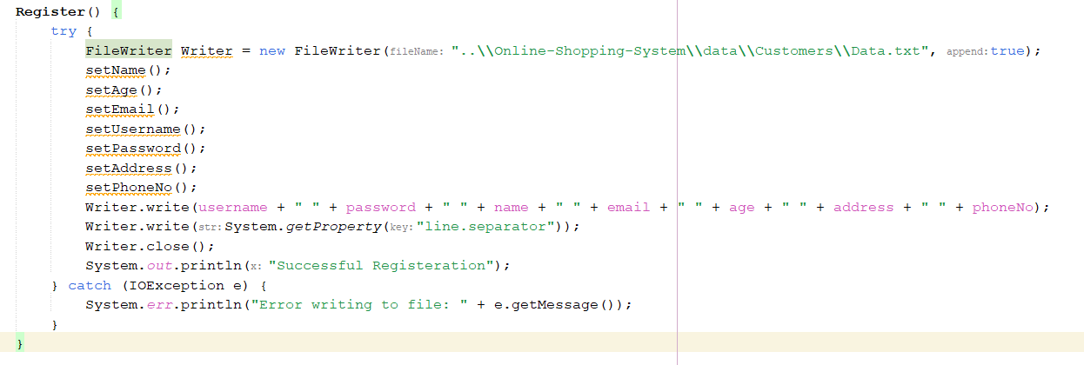
Exception handling
In console:

Slide 20
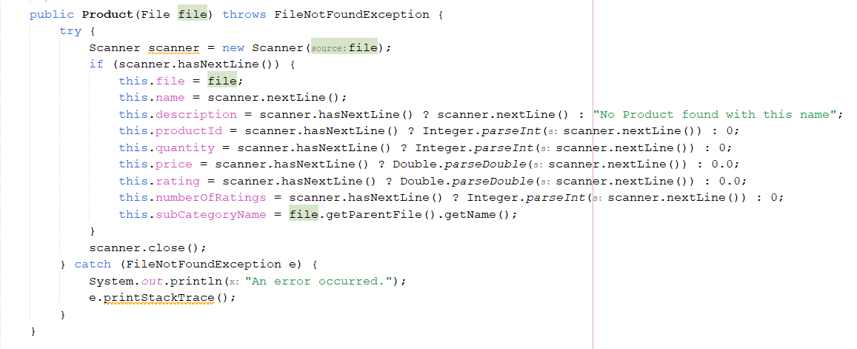
Exception handling #2

Slide 21

In console:

Slide 22
UML DIAGRAM

Slide 23
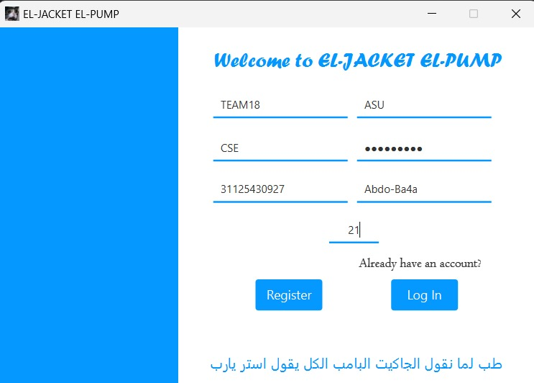
first scene will be registration scene

Slide 24
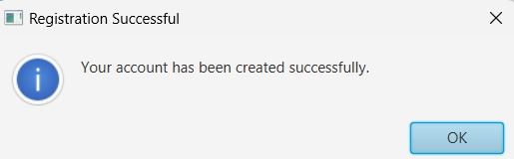
When register button is pressed so the window opens as shown:

Slide 25
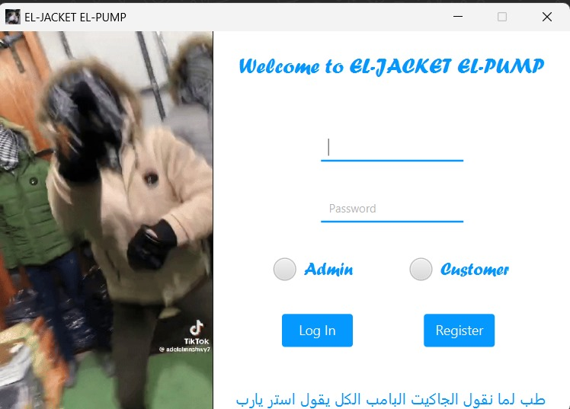
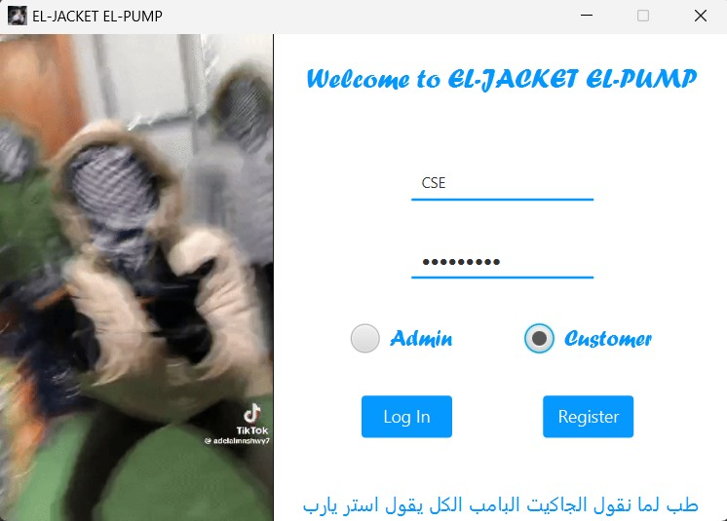
Asking user to login:

Slide 26
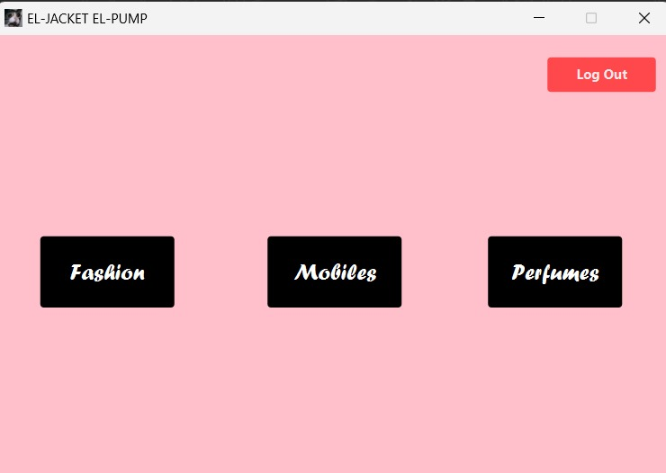
After login subcategories scene appears

Slide 27
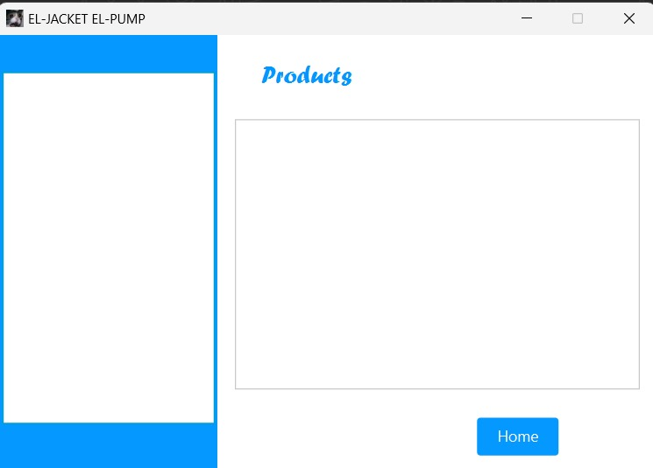
Product scene that should print the available products

Slide 28
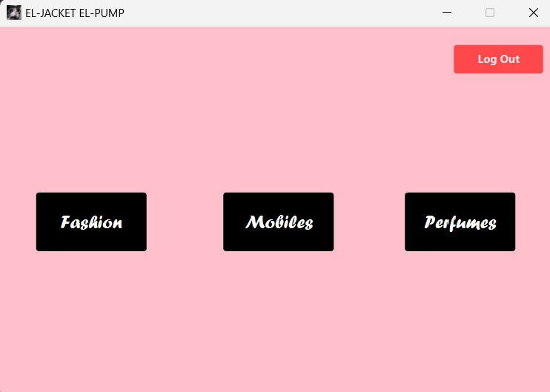
Clicking home:

Slide 29
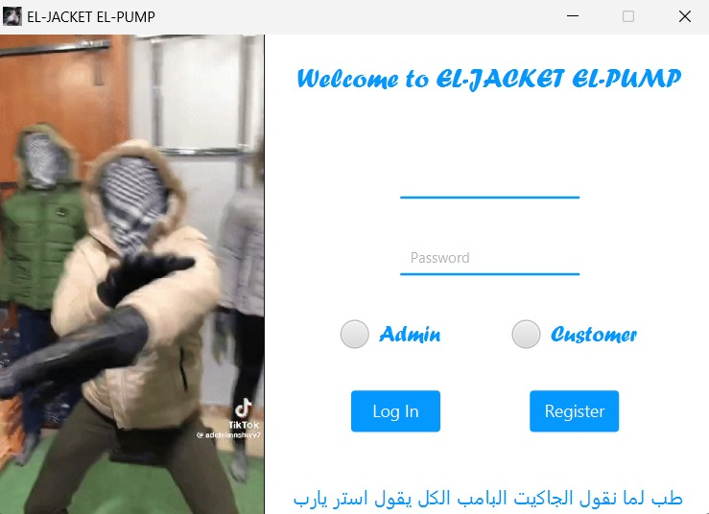
Clicking Logout:

Slide 30
Thank you

